Slide 1


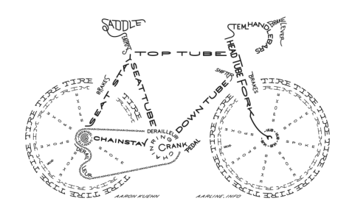

Get Rolling!
How to Keep Your Bike On the Road
Steps You Can Take
Keep your bike clean, especially after ridding through mud or in the winter
Inflate your tires to the recommended pressure
Keep your chain clean and lubricated
Bike Shops Near By
Bay City Cycles
New and used bike retail
Full service repairs
Rent bikes
412 Main Street
Ashland, Wi 54806
Howl Adventure Center
New and used bike retail
Full service repairs
Rent bikes
100 Rittenhouse Ave
Bayfield Wi 54814
And
35265 S. Count Hwy J
Bayfield, Wi 54814
Sunshine Community Bike Shoppe
Provides Repair Services
Rent bikes
Northland College, 1411 Ellis Ave
Ashland Wi, 54806

